Slide 1

SPAM CLASSIFICATION CAPSTONE PROJECT
CSA1363-THEORY OF COMPUTATION
PROJECT BY :
K.Kishore
192211912
D. Surendranadh
192211777

Slide 2

CONTENT
Introduction
01
04
02
Techniques and Algorithms
Evaluation Metrics
03
FUTURE SCOPE

Slide 3

Introduction to Spam Classification
Definition of Spam: Spam refers to unwanted, unsolicited digital communications, typically sent in bulk via email.
Importance of Spam Classification: Effective spam classification is crucial for reducing unwanted emails, protecting users from phishing, and enhancing overall cyber security.
Overview of Spam Classification Techniques: Techniques range from simple rule-based filters to complex machine learning algorithms that adapt to new spam patterns.
Photo by Stephen Phillips - Hostreviews.co.uk on Unsplash

Slide 4
Techniques and Algorithms
Rule-based Filters: Early spam filters relied on manually crafted rules to detect spam based on keywords, sender addresses, and message patterns.
Machine Learning Approaches: Modern spam filters use machine learning algorithms to analyze email features and classify messages based on learned patterns from labeled datasets.
Deep Learning Models: Deep learning techniques, such as neural networks, offer advanced capabilities in understanding complex spam patterns, enhancing accuracy and adaptability.
Photo by Stephen Phillips - Hostreviews.co.uk on Unsplash

Slide 5

Evaluation Metrics
Accuracy: Measures the proportion of correctly identified emails (both spam and non-spam) out of the total emails.
Precision, Recall, F1-Score: Precision: Proportion of true positives out of all predicted positives. Recall: Proportion of true positives out of all actual positives. F1-Score: Harmonic mean of precision and recall.
ROC and AUC: ROC (Receiver Operating Characteristic) curve plots true positive rate against false positive rate. AUC (Area Under Curve) indicates the model's overall performance.
Photo by Isaac Smith on Unsplash

Slide 6
CODE
/#include <stdio.h>
#include <string.h>
#include <stdbool.h>
bool isSpam(const char *emailContent) {
// List of spam keywords
const char *spamKeywords[] = {

Slide 7
"winner", "free", "money", "prize", "click here", "urgent", "buy now",
"limited time offer", "cash", "guarantee", "loan", "risk-free", "unsubscribe"
};
size_t numKeywords = sizeof(spamKeywords) / sizeof(spamKeywords[0]);

Slide 8
for (size_t i = 0; i < numKeywords; ++i) { if (strstr(emailContent, spamKeywords[i]) != NULL) { return true; } } return false; int main() { char emailContent[1000]; printf("Enter the email content: "); fgets(emailContent, sizeof(emailContent), stdin); if (isSpam(emailContent)) { printf("This email is classified as spam.\n"); } else { printf("This email is not classified as spam.\n"); } return 0; }

Slide 9
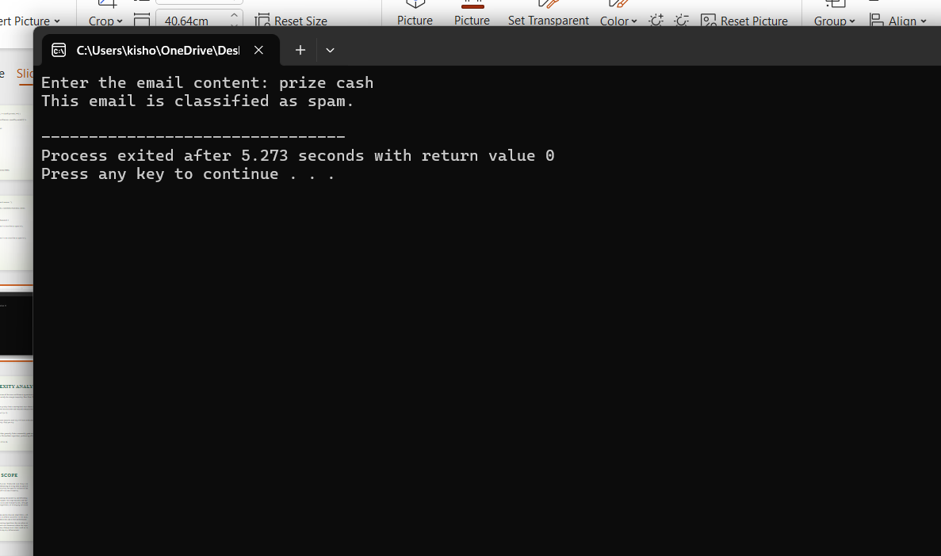

Slide 10
FUTURE SCOPE
Email service providers can integrate the model to improve their spam filters.
Organizations can use the tool to safeguard their communication channels from spam.
Individual users can utilize the application to filter out unwanted emails.
Enhancing cyber security by identifying phishing and malware-laden emails.
Conclusion
naïve Bayes and support vector machines have higher accuracy than the rest, around 91% consistently
. Typically, spam is sent for commercial purposes.
Answering spam just confirms to the spammer that your e-mail address is an active one

Slide 11


